Slide 1
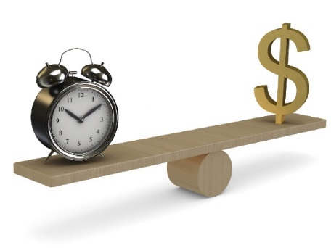
Timely Payment Task Force
Conaway Conference 2015
Chris Engle,
  Director of Public Agencies, Ohio Contractors Association
Gary Angles,
  Administrator Office of Construction Administration, Ohio Department of Transportation

Slide 2
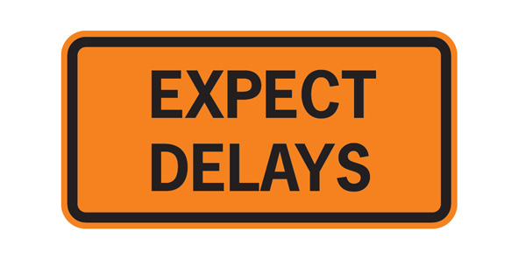
Background
Issues have been discussed and ideas have been tossed around for over 2 years
Agreed to set up a task force to address concerns
This is NOT just an Ohio problem

Slide 3
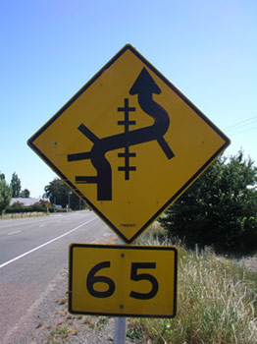
More Background
AGC – Association of General Contractors comments from KS/MD/NC:
“It is usually the owner that is the delay in getting the GC paid in order to pay the subs or MWBE’s ...
Unfortunately the policy makers don’t understand the nature of our industry’s business…
Many of these folks are encouraged to bid these projects and think that when they are awarded the project as a sub, that they will get paid the very day they complete their scope of work…”

Slide 4
The Task Force
Public Representatives
ODOT Representatives
Chris Engle-OCA
Bill Luttmer-A&A Safety
Dennis Bruton-Barrett Paving
Mike Obert-Complete General
Andy Leffler-Shelly and Sands
Dallas Elswick-Twin Rivers Construction
Brad Jones-Construction Mgmt
Gary Angles-Construction Mgmt
Tina Collins-Construction Mgmt
Janet Treadway-Construction Mgmt
Dave Ley-District 7
Chuck Kiner-District 6
Keith Geiger-District 5
Cary Betzing-District 10

Slide 5
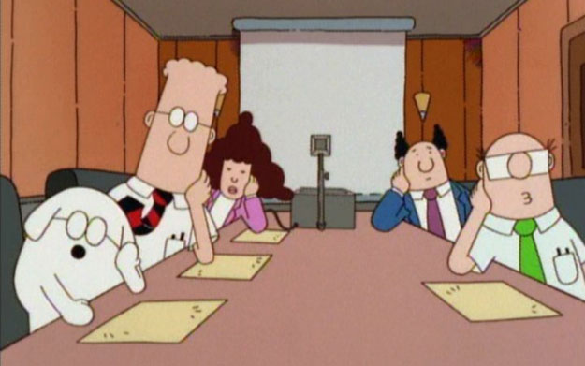
Timely Payment Task Force
Kick Off Meeting 5/23/2014
Purpose of the task force is to discuss reasons why this occurs and evaluate ways by contractors and districts to improve situations where payment is lagging

Slide 6

Items Discussed at Kick Off Meeting 5/23/2014
Balancing non-performance with overages
Processing change orders when items go beyond original plan quantity
CA-D-11
Time extensions and waivers

Slide 7
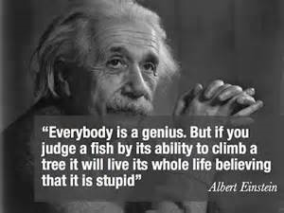
Items Discussed at Kick Off Meeting 5/23/2014 continued
Personnel issues
Force accounts
Other states allow for paying over plan quantity without change orders
Critical success factors

Slide 8
Items Discussed at
Follow-Up Meeting
10/16/2014
Other States allow paying quantity without change orders
Lines of communication to receive payment
CA-D-11
Propose to increase legal limits on projects above $8 million to $400k
Critical success factors
E-Construction

Slide 9
Details of
Follow-Up Meeting
10/16/2014
Law and Concerns
ORC 5525.14 excerpt
(A) Notwithstanding sections 125.01 to 125.11 of the Revised Code, the director of transportation, by written instruction to the contractor, may increase the quantities of any item specified or not specified in a competitively bid construction contract but, except as provided in division (B) of this section, the additional cost incurred by the increase shall not exceed the lesser of one hundred thousand dollars or five per cent of the total contract price. Any such provision for increased quantities or extra work shall be made in the form of a written change to the original contract and does not require competitive bidding…..

Slide 10
Details of
Follow-Up Meeting
10/16/2014
If the Contractor is not paid in a timely manner, follow-up in this order:
Project Manager/Engineer
Area Engineer
District Construction Administrator
CO Construction Management

Slide 11

Details of
Follow-Up Meeting
10/16/2014
If the Sub-Contractor is not paid in a timely manner, follow-up in this order:
Prime Contractor
Project Manager/Engineer
Area Engineer
District Construction Administrator
CO Construction Management

Slide 12
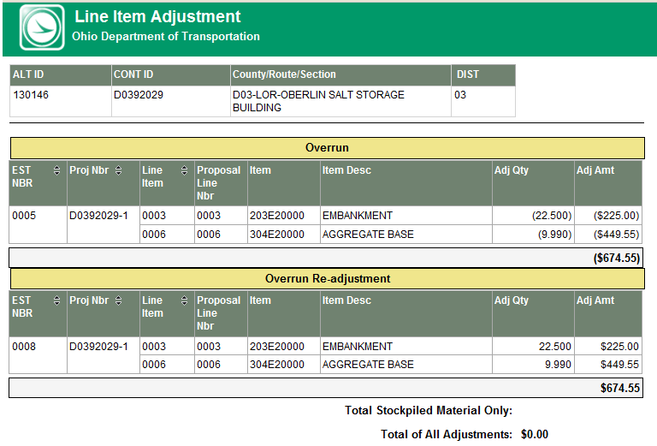
Details of
Follow-Up Meeting
10/16/2014
Line Item Adjustment In SiteManager:

Slide 13
Details of
Follow-Up Meeting
10/16/2014
CA-D-11
Prime not getting sub-contractors to sign off
Issues and differences not getting resolved

Slide 14
Details of
Follow-Up Meeting
10/16/2014
Revise Contract Limits:

Slide 15
Details of
Follow-Up Meeting
10/16/2014
Inflation Impacts
Back in 2001, the Department had fewer projects over $2,000,000. Now, most resurfacing projects exceed $2,000,000
Changes will adjust for inflation for the last fifteen years and the next fifteen years

Slide 16
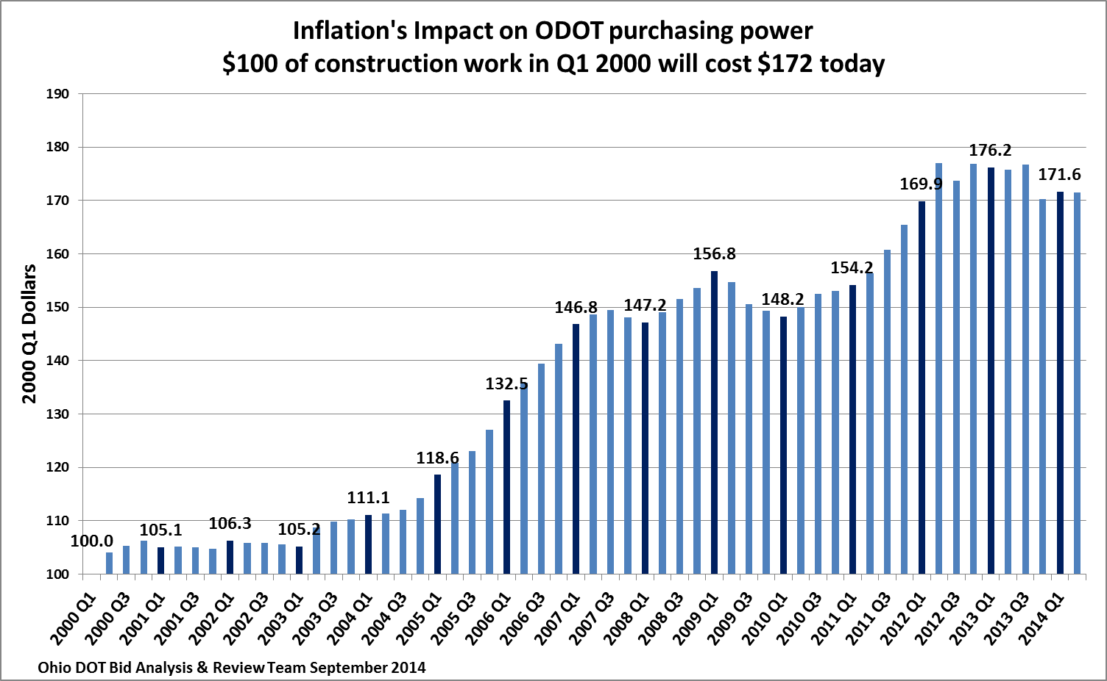

Slide 17
Details of
Follow-Up Meeting
10/16/2014
Current Critical Success Factor

Slide 18
Prompt Payment Measurement
What is it:
A review of the payments on the original contract work after project acceptance
Components:
Projects that are completed and finalized
A measure of dollars paid after the project has been accepted plus 15 days
Based on a rolling 365 day calendar
Extra work and price adjustments are excluded from the measurement

Slide 19
Prompt Payment Measurement

Slide 20
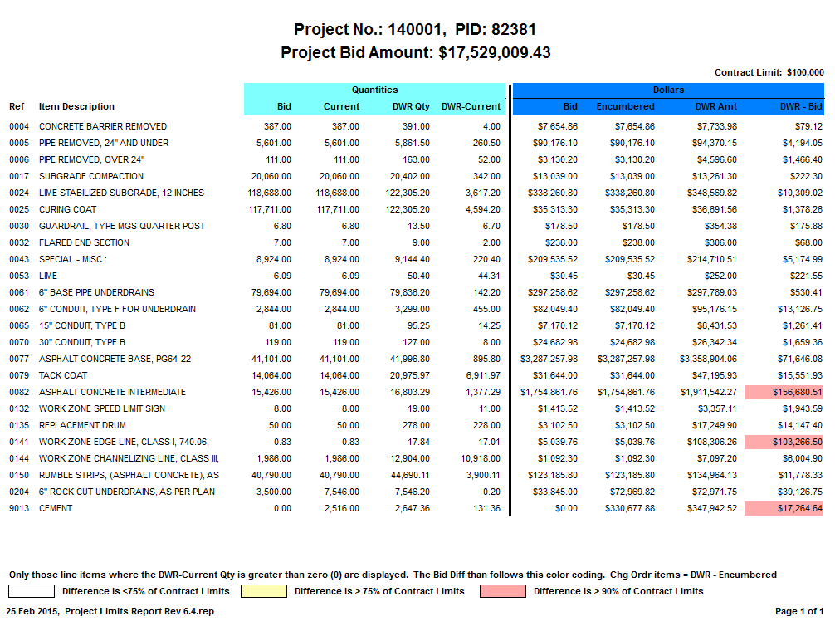
Bid Item Tracker Query

Slide 21
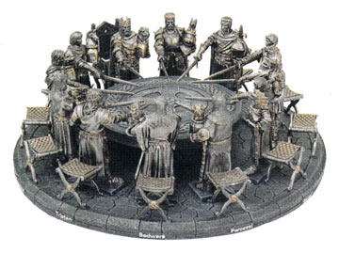
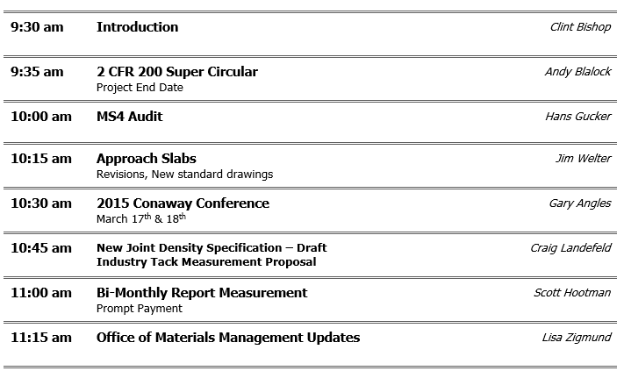
District Construction Administrators Meeting
Items are discussed at DCA and OCA Heavy Highway meetings

Slide 22

Partnering
The goal of Partnering is to build a good working relationship
Issues are addressed in a timely manner
If there are delays in payments, issues can be worked out

Slide 23
E-Construction Initiatives
Going to E- Construction to depend more on online data entry
Approvals via Electronic signatures and work flow processing
Bid Express expansion
CRL, DBE & PW systems coming online

Slide 24

E-Construction Initiatives
E-Construction goals
EDC3 – FHWA / CO purchasing
5 tablets per districts

Slide 25
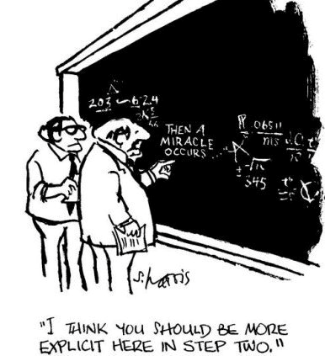
Summary!
If a Contractor is not paid in a timely manner, follow-up in this order:
  Project Manager/Engineer
  Area Engineer
  District Construction Administrator
  CO Construction Management

Slide 26
Questions?

